Slide 1


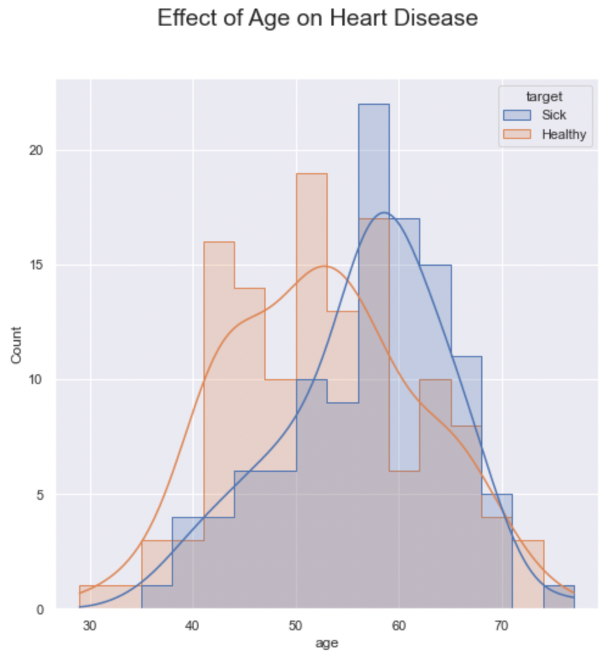
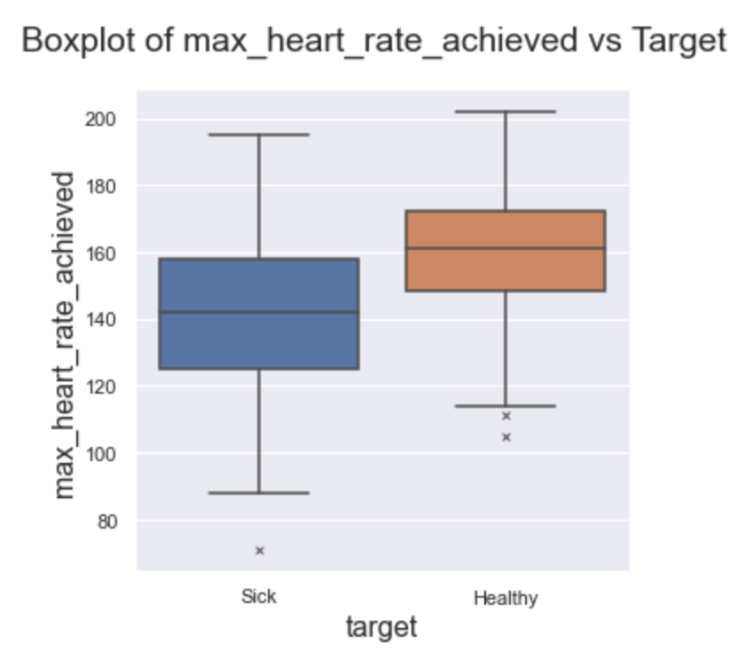
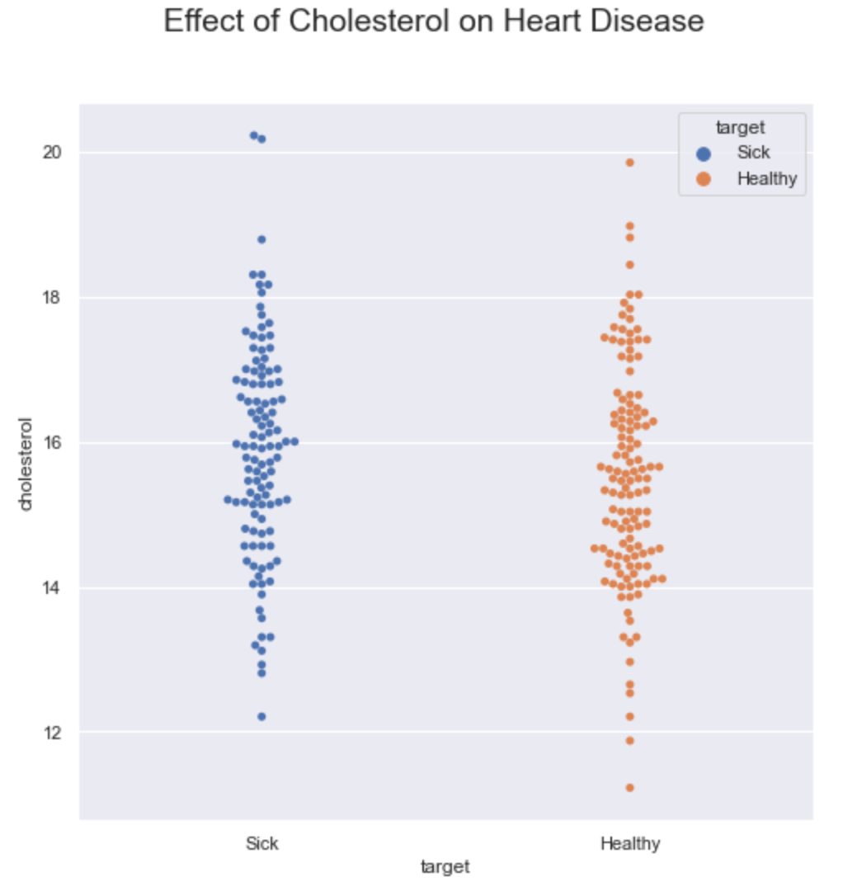
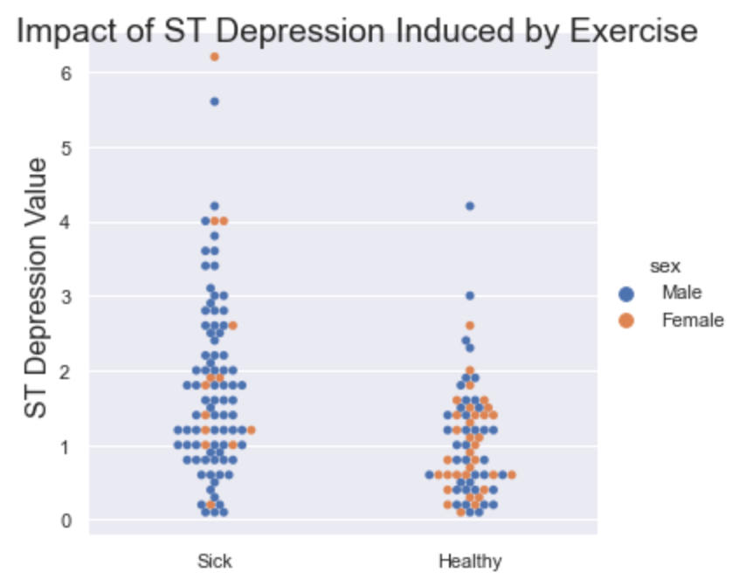
The Importance of Context in Model Selection
Predicting Heart Disease: A Comparison of Machine Learning Algorithms and Transformation Techniques
Khushnur Binte Jahangir, Adam Broniewski
What is the Challenge?
Predict if someone has heart disease based on 13 measures of health.
Apply various data preparation, data transformation, and machine learning techniques. Choose the best methods given the data context.
The dataset:
303 instances:
13 attributes:
Age, sex, chest pain type, resting blood pressure, cholesterol, fasting blood sugar, resting electrocardiographic results, max heart rate after exercise, exercise induced angina, ST depression induced by exercise, # of major vessels visible, thalium stress
Target: 139 with and 164 without heart disease.
Model Building
Four models were tested:
Logistic Regression
Decision Tree
Random Forest
Neural Network
Model tuning was done applying different combinations of parameters using a grid search. Computationally expensive models used a random gird search for breadth of selection, and smaller ranges in regular grid search for fine tuning.
Each model was tested using:
Full training dataset
Feature selected dataset
Testing Different Approaches
Steps Taken
Extracted Information
EDA
Correlation
Visualization
Trends and Descriptions
Feature Selection
Model Building
Exploring the Data
No correlation:
fasting blood sugar, cholesterol and resting blood pressure
Positive correlations:
Age (especially in men), ST depression seen after exercise
Negative correlations:
maximum heart rate achieved after exercise
Validation: Using Context to Identify the Best Approach
We compare our two top performers using four metrics. F-score showed average of precision and recall, but each metric was considered independently. False negatives can have life altering consequences.
Logistic regression chosen for interpretability. Small increase in performance of neural network not deemed worthy of loss of contextual information.
All Features
Select Features
Model | F-score | Precision | Recall | Accuracy
Neural Network | 0.831 | 0.839 | 0.829 | 0.834
Logistic Regression | 0.826 | 0.836 | 0.826 | 0.830
Logistic Regression
Decision Tree
Random Forest
Neural Network
Validation
Validation
Validation
Validation
Testing
Future Extensions
Model Accuracy
Testing the Best: Results
Logistic regression predications on test data generally had similar results to validation. Precision decreased and recall increased.
Evaluating F-score or accuracy alone would not have revealed change in performance.
Trying Again: Future Extensions and Issues
Amount of Data: Limited dataset made multiple layers of stratification impractical.
Different Folds: 5-fold (instead of 10-fold) means fewer instances in model building. Try different validation methods for neural network and random forest.
Feature Selection: Try one-hot encoding ordinal features, as severity change between steps is unknown. Use random forest to programmatically select features.
Regularization: Given success of feature selection, apply lasso or ridge method to vary the weight of features.
Model | F-score | Precision | Recall | Accuracy
Test Results | 0.836 | 0.781 | 0.893 | 0.836
Validation Results | 0.826 | 0.836 | 0.826 | 0.830

